Slide 1
Great Western Advisory
MetisMax “Goals to Results” Methodology Overview
Copyright 2022 by Great Western Advisory LLC.

Slide 2
Every person and organization is on a journey from goals to results …
Results. Outcomes. Whatever word we use, individuals and organizations continuously look to achieve something. Sometimes the goal is precise and well-defined, and sometimes it is vague and takes the form of something along the lines of “We want something better than we have now.”
But we often fail in moving from goals to results in an efficient and verifiable manner:
There are hundreds of books on goal setting…but goal setting is only the first step.
Goals define WHERE we want to go…but goal setting does not tell us WHAT is required to achieve the goal nor HOW the goal will be reached.
Goal setting also does not tell us HOW MUCH we need to do nor how we should MEASURE and CONTROL our efforts.
Finally, goal setting does not require we take stock of our READINESS to embark on the journey from goals to results.
1
5

Slide 3
Great western’s metismax methodology bridges the gap from goals to results
Goals
Results
Great Western’s MetisMax Methodology: Step by Step | 1) Understand Goals and Requirements | 2) Gather Different Perspectives to Develop Solutions | 3) Understand How Individual Solutions Work Together in an Integrated Way | 4) Develop Results-based Performance Measures | 5) Assess Solution Implementation Readiness
Methodology Details | Focus on understanding goal-driven requirements and requirement relationships first, thus avoiding “short-circuiting” to subjective solutions based on “gut feel” or “past experience” only. | Bring multiple functional experts together in a collaborative environment to develop a balanced and well-informed set of requirements and solutions. | Evaluate how individual solutions correlate so synergies and dependencies can be identified and managed to achieve the most effective and efficient outcomes. | Develop only the performance measures needed to assess and manage results, thus avoiding measuring things that do not matter. | Conduct a high- level readiness assessment that can be expanded to any level of detail and supported by customizable implementation management tools.
2
5

Slide 4
The value of our results-focused approach
Our clients consistently make objective, logical and defendable decisions that allow them to own their future. The value of our approach includes:
Universal . . . results can be achieved for any type of goal the organization wants to achieve regardless of type or topic.
Collaborative . . . energizes cross-functional and cross-organizational communication, innovation and creative problem solving.
Objective and Data-driven . . . methodology drives to analytically supportable and quantifiable decisions at each step.
Cost Effective . . . develops goal-targeted solutions/actions in a fraction of the time of traditional group brainstorming and problem-solving techniques.
Performance Focused. . . develops performance targets and measures directly traceable to solutions, requirements and the original goal.
Implementation Ready . . . since analytics for each step of the methodology is captured in our Microsoft™ Power Apps tool, they can be easily exported into the Microsoft Power Apps suite for use in customized management dashboards and project management tools.
3

Slide 5
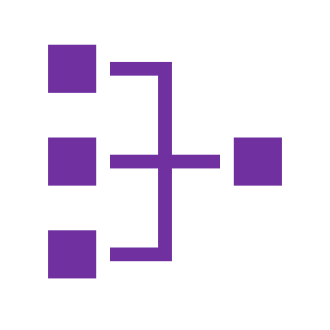
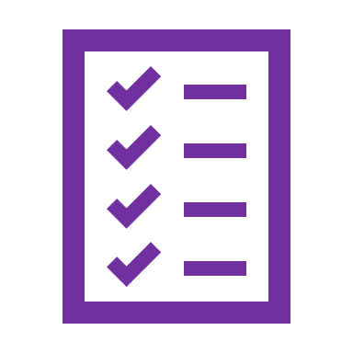
We apply this methodology through customized solutioning sessions with our clients using our cloud-based tool
Client Results Team
Great Western Team Facilitator
Great Western Facilitator works with Client Results Teams to set Goals and complete each step in the methodology, in person or through cloud-enabled Solutioning Sessions
Our Facilitator works with Client Results Teams to develop Goal-focused Solutions/Actions with supporting analytics, performance measures and an Implementation Readiness Assessment all captured in our cloud-based Microsoft™ Power Apps tool
Solutions/Actions are documented in a Final Goal Blueprint and Implementation Road Map Report for solution implementation and goal achievement
7
4

Slide 6
WE ALSO facilitate the MetisMax methodology at the organizational level
ORGANIZATIONAL FACILITATION . . .
Great Western can provide MetisMax Methodology decision support across the organization. Clients may choose from three levels of support on a time and materials (T&M) basis customized to their needs:
Initiative Level | Portfolio Level | Enterprise Level
For any individual goal, project, product or service, Great Western works with client team members to develop an analysis and final report that details the solutions/actions required to move from goals to results. | For a collection of projects or for a specific organizational unit with one or more initiatives, Great Western works with portfolio owners to develop multiple analyses and final reports that detail the solutions/actions required to move from goals to results. We also work to effectively prioritize, integrate and sequence the projects across the portfolio or unit. | For enterprise level goals or initiatives, Great Western works with client leadership to apply the methodology to move from goals to results. Examples may include: Strategic Plan Development Human Capital Initiatives Technology Development Vendor and Acquisition Management Program Management
5
5

Slide 7
WE can also provide customized implementation support
CUSTOMIZED IMPLEMENTATION SUPPORT . . .
Technology Support . . . Since analytics for each step of the methodology is captured in our Microsoft™ Power Apps tool, they can be easily exported into the Microsoft Power suite for use in customized management dashboards and project management tools. Great Western can develop customized Power Apps dashboards and analytics for solution management using:
Power BI
Power Automate
Implementation Optimization . . . If our Implementation Readiness Assessment identifies actions that should be taken to optimize solution(s) implementation, Great Western can provide optimization consulting including:
Business Process Reengineering
Organizational Redesign and Change Management
Human Capital Services and Support
6
5

Slide 8
The MetisMax methodology in action
Organizations can use the methodology to achieve results for any goal, initiative or problem they wish to solve. This includes:
Planning . . . plans that deliver quantifiable and measurable results.
Process Improvement . . . lean processes that deliver customer value.
New Product or Service Development . . . products and services laser focused on customer expectations.
New Projects, Programs or Initiatives . . . efficiently move from concepts to verifiable outcomes.
Designing and Improving Internal Operations . . . from human resources to finance or shared services, internal processes tailored to support the mission.
Acquisition . . . service level agreements that drive consistent vendor performance through quantifiable performance specifications and surveillance.
Proposal Development . . . winning proposals that stand out from the competition with results-focused technical approaches and quality plans.
“Turbocharge” Existing Business Tools or Capabilities . . . easily integrates with an organization’s existing decision support tools providing additional analytic rigor and risk management capabilities.
7

Slide 9
Great Western Advisory
Results. Done. Differently.
Keith Phillips
President
+1 (703) 304-6503
kphillips@greatwesternadvisory.com
8
2

