Slide 1
Results . Done . Differently .
Great Western Advisory
ISO 9001:2015 Quality Management System
The Great Western Mini Guide to Achieving ISO Certification for Federal Contractors
Copyright 2022 by Great Western Advisory LLC.

Slide 2
An increasing number of federal contracts are either requiring ISO certification or are including certification as an evaluation factor component . . .
This briefing provides an ISO 9000 overview and provides guidance on how to most effectively prepare for successful certification.

Slide 3
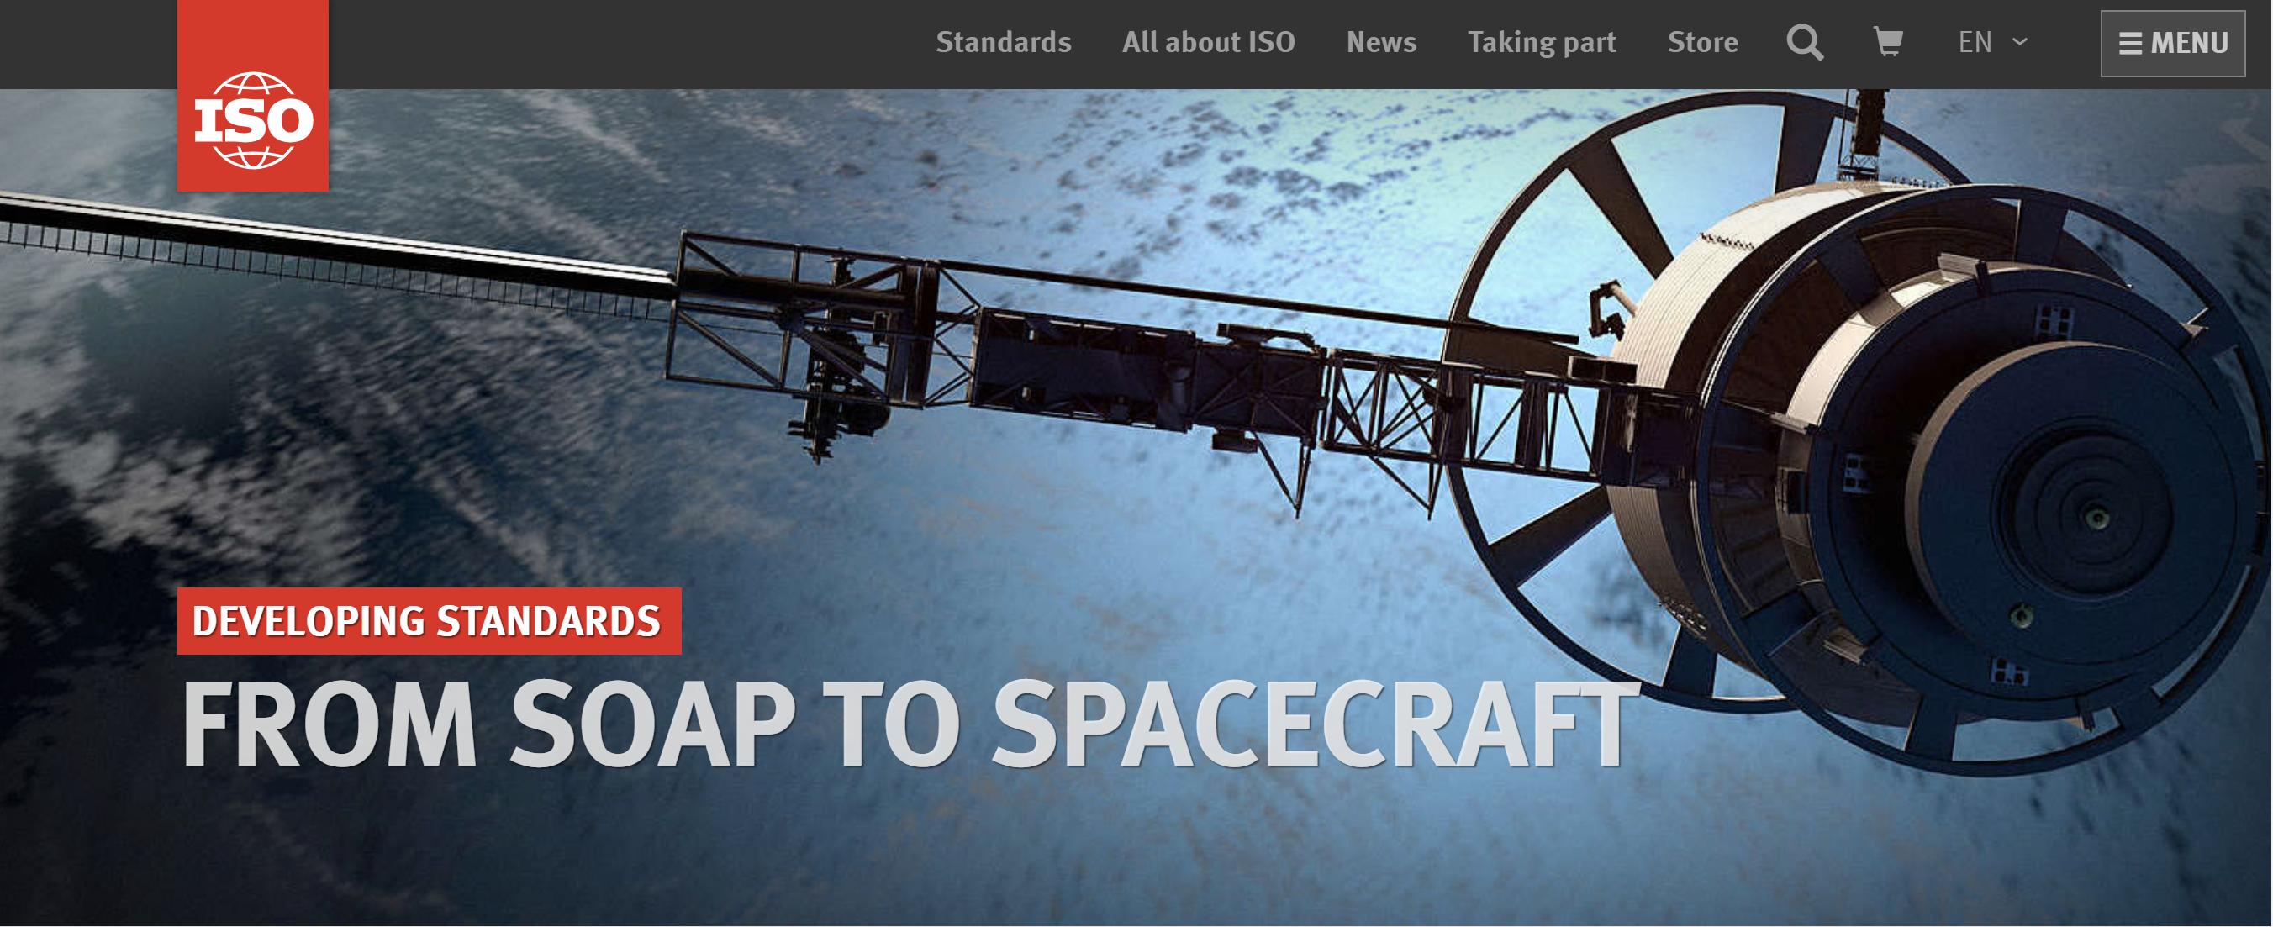
What is ISO?
International Standards Organization (ISO) is based in Geneva, Switzerland
Over 160 countries are members of ISO, including the U.S.A.
ISO develops a variety of quality standards, such as traffic symbols, material standards, inspection practices and the ISO 9000 quality management system

Slide 4
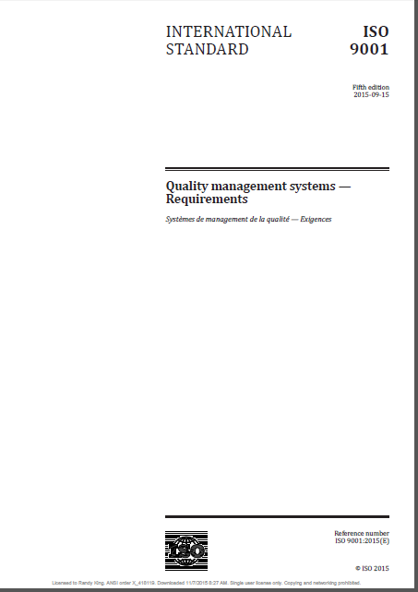
What is ISO 9001?
In 1987, ISO published “ISO 9001” a document (or standard) that lists some internationally-accepted, basic rules for a Quality Management System (QMS)
Remember:
“ISO” is an organization
“ISO 9001” is a document that defines the quality standard
“ISO 9001: 2015” is the current version of the quality standard that details seven (7) quality management principles
ISO 9001:2015

Slide 5
The seven (7) ISO quality management principles
Principle 1: Customer focus
Principle 2: Leadership
Principle 3: Engagement of people
Principle 4: Process approach
Principle 5: Improvement
Principle 6: Evidence-based decision making
Principle 7: Relationship management

Slide 6
ISO 9001:2015 is structured into ten (10) clauses (or elements) that provide guidance for the contents and execution of the organization’s quality management system (QMS)
Clause 1: Scope (of the QMS)
Clause 2: Normative References (defined in the ISO 9000:2015 standard)
Clause 3: Terms and Definitions (defined in the ISO 9000:2015 standard)
Clause 4: Context of the Organization (in relation to its approach to the QMS)
Clause 5: Leadership (how leadership supports the QMS)
Clause 6: Planning (how planning is accomplished to meet QMS and ISO guidance)
Clause 7: Support (how the Company supports employees in the execution of the QMS)
Clause 8: Operation (the processes, policies and procedures used to manage the QMS)
Clause 9: Performance and Evaluation (how the Company assesses and controls the QMS)
Clause 10: Improvement (how the Company continuously evaluates the QMS and its operations for improvement)

Slide 7
Certification is granted by an external, third-party auditor who reviews a Company’s QMS and certifies that it is compliant with ISO 9000:2015 and its ten clauses
During the audit, the auditor will review the Company’s documentation on how the organization designs, executes and controls its QMS as part of the way the organization conducts its business
The auditor will also interview a sample of the Company’s employees to ensure that they understand and use the QMS in the execution of their work
The ISO 9001 Quality Standard defines the types of things a Company should do to meet the intent of the Standard, but it does not define how the Company should go about achieving these things. While the Company has broad latitude to develop a QMS that best fits their business and customers, it must meet the ISO 9000 guidance defined in the standard.
If identified, the auditor will detail any areas of “non-compliance” that must be corrected before ISO certification is granted
Once corrected, the auditor will re-audit the Company and, if non-compliance items have been corrected, will grant ISO certification to the Company

Slide 8
(Some) typical audit questions for Company leadership . . .
Why did the Company decide to pursue certification?
How does the Company implement the major elements of the QMS?
How is QMS documentation developed and controlled?
How are employees trained and supported in the use of the QMS?
How is the QMS resourced and supported?
How does the Company use the QMS to meet customer needs?
How does the Company ensure desired quality results are achieved?
How does the Company ensure the integrity of the QMS is maintained when changes to Company processes, customers, or other things occur?

Slide 9
(Some) typical audit questions for Company rank-in-file employees . . .
What is the Company’s QMS and how you use it in the daily performance of your work?
How were you trained on the QMS and how are quality expectations communicated?
What quality procedures do you use to do your work?
How do you monitor the quality of work and what do you do when you identify an error in quality or work delivery?
How are quality or work-related records kept and for how long?
Where do you go for quality-related tools or information?
How and to whom do you identify and communicate ideas for improvement?

Slide 10
The auditor will also review samples of the Company’s QMS documentation to ensure it satisfies ISO guidance
The link between the QMS and the corresponding documentation that defines and manages it cannot be ignored if the Company wants to achieve certification in the most efficient way possible
Since the auditor may have little to no knowledge about the Company’s business or its QMS, they will depend heavily on ensuring the Company’s documentation complies with the ISO guidance.
Documentation can be used to train leadership and employees on the QMS and can serve as an ongoing procedural reference to ensure the QMS is being adhered to in the daily operation of the Company. The minimum documentation required by ISO 9000: 2015 includes:
Nine (9) required documents (mapped to five of the clauses)
Eighteen (18) mandatory records (mapped to four of the clauses)
Exceptions to the need for some these documents/records may be developed if they are not relevant to the organization’s customers and operations
NOTE: While a Quality Manual is no longer required under ISO 9000: 2015, organizations may want to collect and manage these documents and records within a controllable Quality Manual.

Slide 11
“Red flags” for the auditor (that may lead to a failed initial audit)
The ISO 9001 auditor/certifier does not expect 100% perfection on the part of the audited Company and its staff to grant certification. However, several types of deficiencies/behaviors will cause the initial audit to fail. These include:
Company leadership that does not understand and cannot communicate the value, intent and execution of the QMS within the Company's culture and operations
A perception that the Company is only pursuing the certification to “check a box” and is not actually committed to using the certification process to improve operations, customer service/quality delivery and competitiveness
Inability on the Company's part to produce version-controlled documentation that is consistently used to support the QMS
Inability on the part of the Company's rank-in-file staff to describe the overall QMS and their roles and responsibilities within it as part of doing their work
In general, Companies that “Say What They Do, Do What They Say and Can Prove It via Documentation,” with respect to the ISO 9001 Quality Standard, will have a higher likelihood of passing the audit on the first try

Slide 12
ISO certification must be maintained after the successful initial certification
Initial ISO certification is good for three years, after which re-certification must be conducted
Annual “surveillance audits” are conducted by the original auditing body
Internal audits done by Company leadership and staff can make surveillance and re-certification audits easier

Slide 13
Great Western Advisory can help federal consulting companies efficiently achieve ISO certification with a minimum of headaches and re-work
Our staff are quality experts and certified ISO 9000 Lead Auditors who bring over 30 years of quality design and implementation experience. We can:
Develop all required ISO-compliant documentation customized to the Company
Train and coach leadership and rank-in-file employees on the ISO standard, the QMS and the audit and certification process so they can effectively participate in the third-party audit
Support QMS implementation within the Company
Conduct preparatory internal audit and interviews, i.e., a “black hat” audit evaluating the things the auditor would evaluate
For more information contact:
Keith Phillips: kphillips@greatwesternadvisory.com

